Slide 1

Introduction
PARADISE
Supervisor: Mr. Cat Nghiem Hieu Tuan
Le Cong Dat – Student1022144
Tran Thi Tuyet Duyen – Student1030933
Tran Tan Duy – Student1053750
22 May 2019

Slide 2
Content
Introduction
Actual requirements
Requirements of the project
Deployment diagram
Test result
Conclusion and development
Task list

Slide 3
Introduction - Actual requirements
Building a website to enter e-commerce market of Pet
Services
Shop
Pet Dating

Slide 4
Introduction - Requirements of the project
Functional
Admin:
View;
Update (existing product) gallery, services.. ;
Delete Product (supper admin role)
User:
Search for service, product, partner to date with.
Register account
Book service: pet care, pet grooming, pet hotel
Buy products: food, carrier, toy, kennel, collar, treatment products..
Take part in Pet dating club
Notes:
Non-functional (how the system works)
Functional (what the system should do)

Slide 5
Introduction - Requirements of the project
Non-functional
HARDWARE | SERVER
 | Minimum | Recommended
Processor | 800 MHz Intel Pentium III | 2.6 GHz Intel Pentium IV
Memory | 2 GB | 4 GB
Disk space | 8 GB | 16 GB
Monitor | Super-VGA (800x600) or higher resolution monitor
Internet | Internet access is required
 | CLIENT
Processor | 800 MHz Intel Pentium III
Memory | 512 MB
Monitor | Super-VGA (800x600) or higher resolution monitor
Internet | Internet access is required
SOFTWARE | SERVER
Operating System | Windows XP or later
Browser | Google Chrome 65.0
Database | Microsoft SQL Server 2014
Software | Java SDK 1.8
 | GlassFish Server 4.0
 | CLIENT
Operating System | Windows XP or later
Browser | Google Chrome 65.0
Notes:
Non-functional (how the system works)
Functional (what the system should do)

Slide 6
Introduction - Requirements of the project
Non-functional
DEVELOPMENT SOFTWARE
Microsoft Windows 10
TECHNOLOGY
J2EE
Java SDK 1.8
Netbeans IDE 8.2
Atom 1.36
SQL Server 2016
Google Chrome 74.0
WampServer 3.1.3
Glassfish server 4.1.0
EJB
HTML/CSS
JavaScript
Angular 7
REST API
JWT Token 0.9.1
Node.JS and NPM
Notes:
Non-functional (how the system works)
Functional (what the system should do)

Slide 7
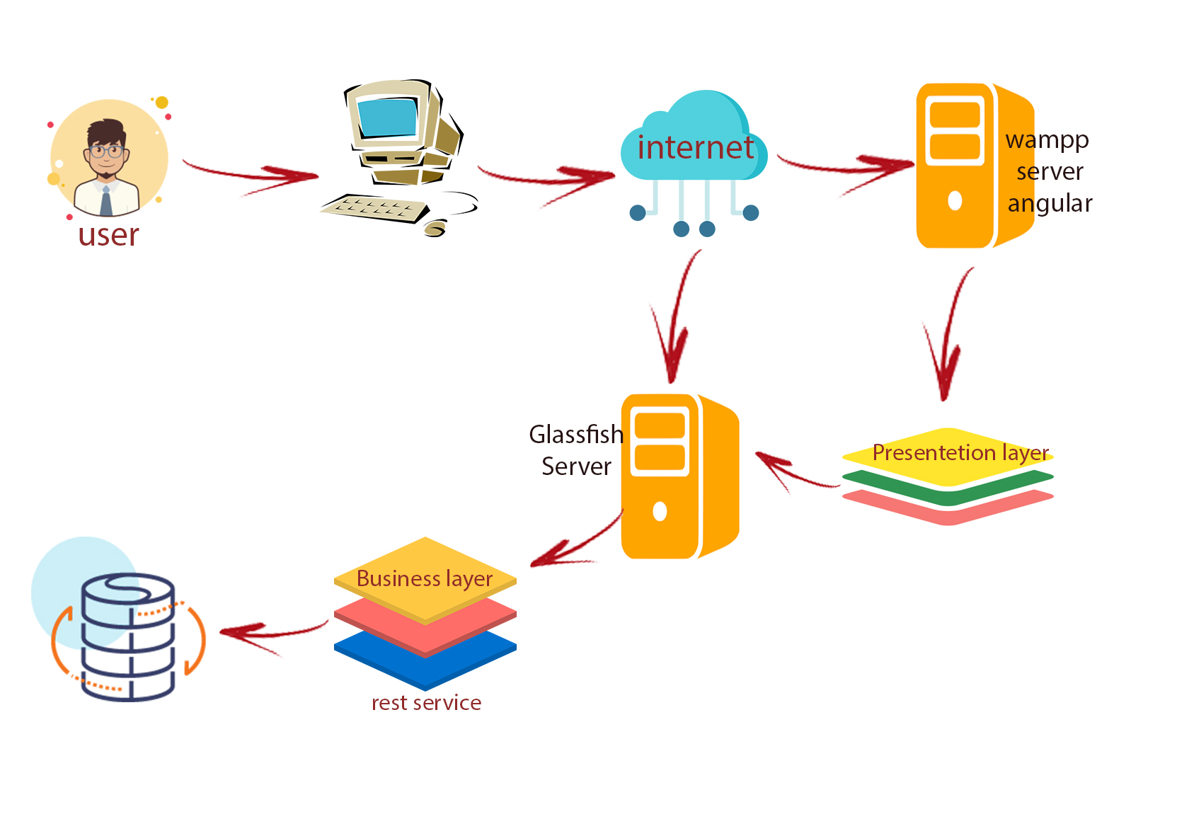
Introduction - Deployment diagram

Slide 8
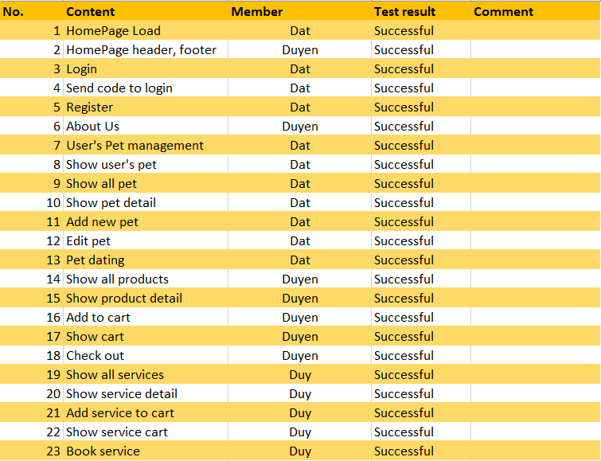
Test Result [1-n]

Slide 9
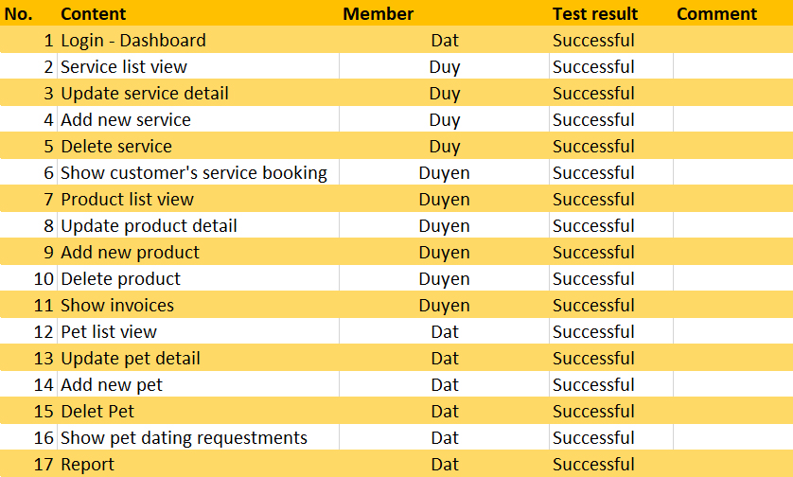
Test Result [2-n]

Slide 10
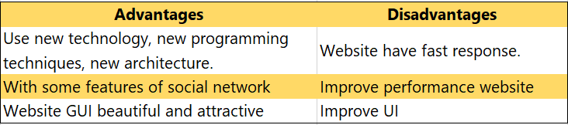

Conclusion

Slide 11
Task List
Review 1: 05-08, April
Introduction, Customer requirement, Functions requirement.
Review 2: 14-21, April
Use case and sequence diagram, Flow chart, ERD design, Database design.
Review 3: 17, April – 07, May
Website GUI design
Website backend programming

Slide 12

Thank You

